Slide 1
Advanced Design Methods (MDO, KBE) AE4233
MDO Practical session 2
Dr.ir. G. La Rocca
Dr.ir. H.A. Visser
Ir. D. Steenhuizen
Dr. A. Elham
Flight Performance & Propulsion Group (FPP)
Structuring a Multi-Disciplinary Optimization problem

Slide 2
Overview
Example Problem
Multi-Discipline Feasible scheme
Individual Discipline Feasible scheme

Slide 3
Overview
Example Problem
Multi-Discipline Feasible scheme
Individual Discipline Feasible scheme

Slide 4
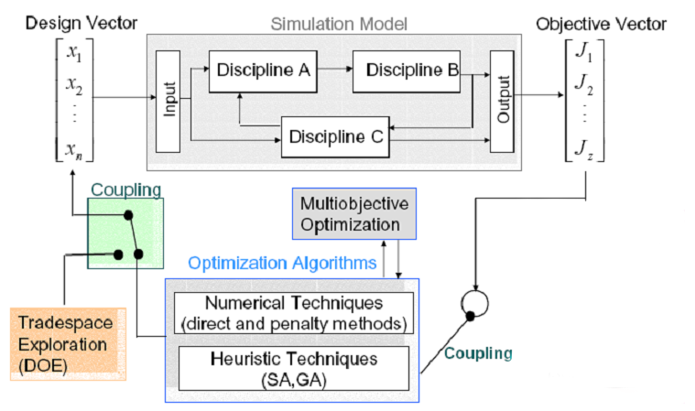
Optimization algorithm

Slide 5
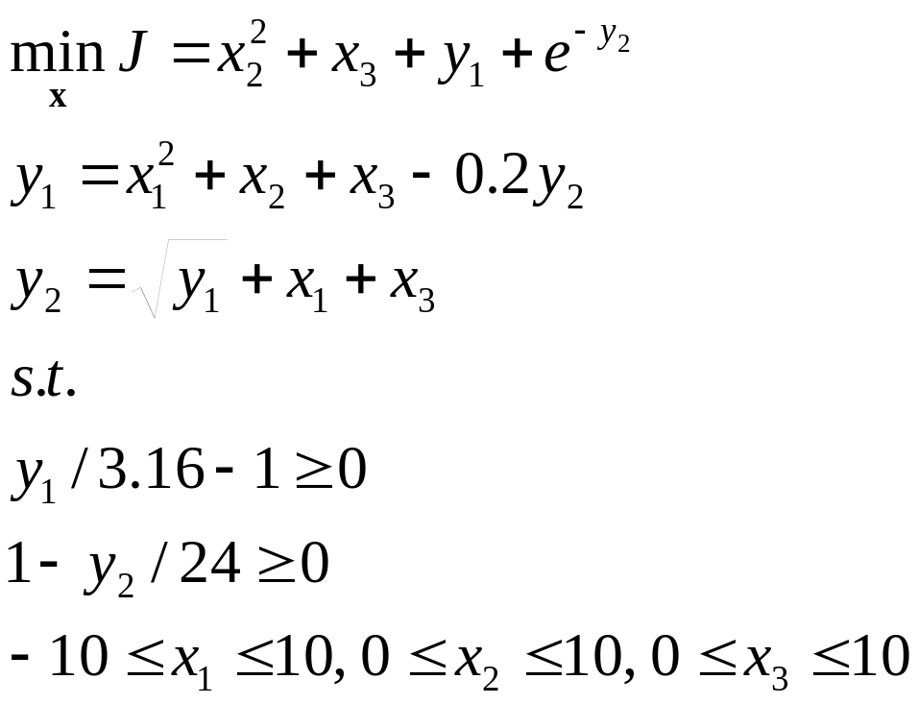
Example problem
Discipline 3; objective
Discipline 1
Discipline 2
Source: AIAA 2004-4537

Slide 6
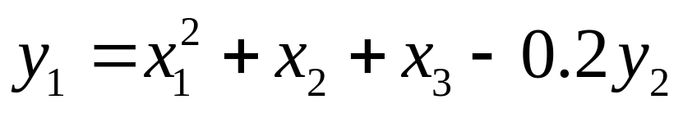
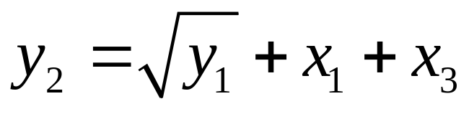
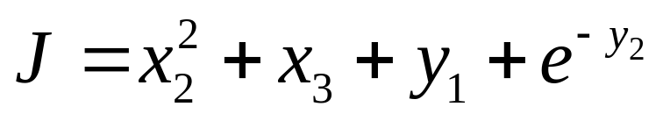
Sub-systems I/O
x₁, x₂, x₃, y₂
y₁
x₁, x₃, y₁
y₂
x₂, x₃, y₁, y₂
J

Slide 7
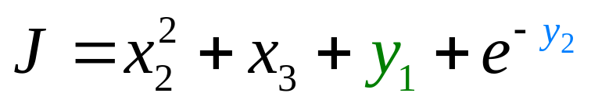
Sub-systems I/O
x₁, x₂, x₃, y₂
y₁
x₁, x₃, y₁
y₂
x₂, x₃, y₁, y₂
J

Slide 8

Interaction between 2 subsystems
Sub-sys 1
x₁, x₂, x₃
Y_{1,cons} y_{2,cons}
y₁
y₂
Sub-sys 2
design vector
consistent y’s

Slide 9
Aggregate sub-system
The aggregate of the two subsystems can be viewed as a black box itself
This black-box takes as input the design vector X
This aggregate black box is characterised by its state vector Y
For a feasible design to ensue, this black box’ state should be consistent, i.e. both sub-systems are in agreement with each other

Slide 10
Recap question
What is the mathematical relation that is generally used to evaluate and assert a (sub)-system’s level of consistency?
What exactly is the mathematical state that is used to assert consistency of a (sub)-system?
r_{i} = s_{i} – s_{i}*
r_{i} = 0

Slide 11
Overview
Example Problem
Multi-Discipline Feasible scheme
Individual Discipline Feasible scheme

Slide 12
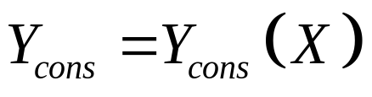
MDF approach; build system coordinator
In the MDF approach, a system coordinator is built inside the aggregate black-box.
This coordinator will iterate the aggregate system for a fixed value of the input X, until consistency is reached for state Y
The consistent state vector Y_{cons} will be passed forward as output
Effectively, the aggregate system’s solution is rendered as a function of input X:

Slide 13
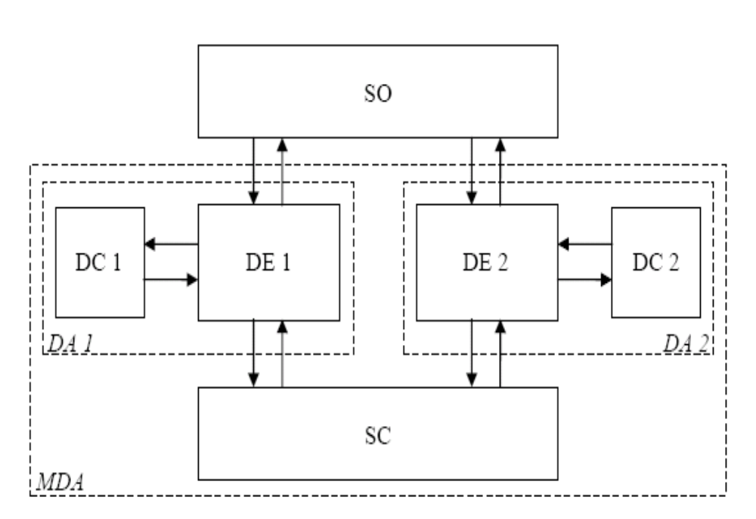

MultiDiscipline Feasible; System Coordinator
X
Y|_{X}

Slide 14
Characteristics of the MDF approach
In an MDF scheme the system optimizer tries to optimize the aggregate system that is formed by the collection of all sub-systems and its coordinating block(s), in terms of the design vector X
Notably, for MDF every test-design X (thus, for every iteration) that is evaluated for its objective-value has overall system-level consistency. I.e. every sub-system is in agreement with all others for each specified input X
Typically, a coordinator-routine is added, in order to achieve this iteration-wise overall consistency
Responsibility for overall system consistency is assigned to the system-coordinator

Slide 15
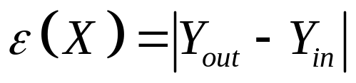
Behaviour of the aggregate sub-system
It is possible to compare input and output vectors of Y after one iteration of the aggregate sub-system
The difference, or error in these values is a measure for consistency
When this error becomes equal to zero, a consistent state Y* has been found (for the given input X)

Slide 16
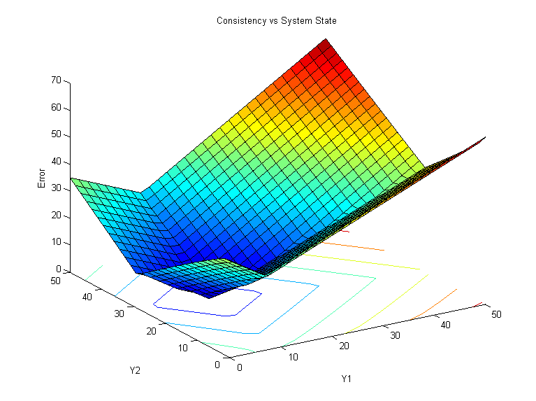
Example consistency behaviour
X =[ 5 2 2]

Slide 17
Iterate until consistent
In order to find the consistent state, an iterative search has to be performed
Just as for an optimization, some starting point must be given for this process
Some termination error-tolerance has to be set for this search routine
Required number of iterations, hence search time, increases with accuracy (i.e. a lower error-tolerance)

Slide 18
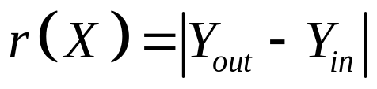

Iterate until consistent
Basic search strategy for this problem:
Start with initial state vector
Evaluate initial state with each sub-system; use outcome to update state-vector (i.e. the new search point)
Evaluate consistency error:
Evaluate updated state-vector with both sub-systems and, again, update its values with the outcome
Repeat 3 and 4 until error is lower than desired value

Slide 19
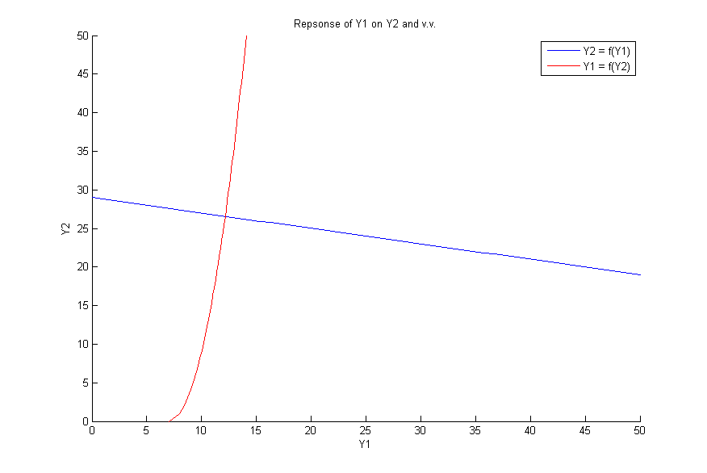
Iterate until consistent
X =[ 5 2 2]
Y_{start} = [ 0 0]

Slide 20
Iterate until consistent
X =[ 5 2 2]
Y_{start} = [ 0 0]

Slide 21
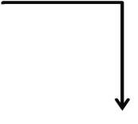




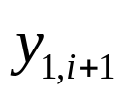

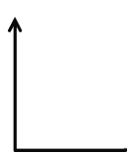
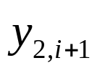



Example DSM (MDF)
SO
 | SC

Slide 22
Example DSM (MDF)
SO
 | SC
LOOP, stop if y_{j,i+1} - y_{j,i} < ε

Slide 23
Assignment
Work out the presented example problem in an MDF optimization scheme in MatLab

Slide 24
Overview
Example Problem
Multi-Discipline Feasible scheme
Individual Discipline Feasible scheme

Slide 25
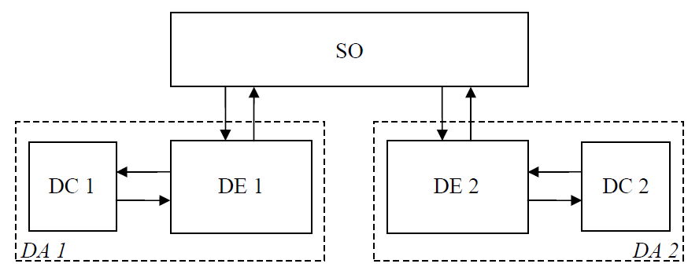
Individual Discipline Feasible (IDF)

Slide 26
Recap question
Why is the Individual Discipline Feasible approach called this way?
How does it differ from the Multi-Discipline Feasible approach in this respect?

Slide 27
Recap question; answer
Why is the Individual Discipline Feasible approach called this way?
The IDF approach has assigned the coordination of inter-system consistency to the optimizer. This optimizer will, parallel to searching for the optimum, search for an inter-discipline consistent solution. Therefore, at each iteration of the optimizer, the sub-disciplines are only self-consistent, but not inter-discipline consistent, except at the final optimum

Slide 28
Recap question; answer
How does it differ from the Multi-Discipline Feasible approach in this respect?
Because the MDF approach includes a dedicated system coordinator, it is ensured that overall inter-discipline consistency is achieved at each iteration of the optimizer. This results in an overall feasible design solution at each iteration, even before reaching the final optimum

Slide 29
IDF approach; tear coupling relations
In the IDF approach the couplings relations between individual sub-systems are removed, or “torn”
The torn state variables are replaced by surrogate variables that are now directly provided by the optimizer
In order to ensure consistency of the sub-systems, extra constraints are added to the optimization problem

Slide 30
Characteristics of the IDF approach
By tearing the coupling variables between sub-systems, these sub-systems will no longer be consistent throughout every iteration (each sub-system is consistent by itself, however)
Responsibility for consistency is assigned to the optimizer
The optimizer is tasked with finding a final design that is both consistent and optimal

Slide 31
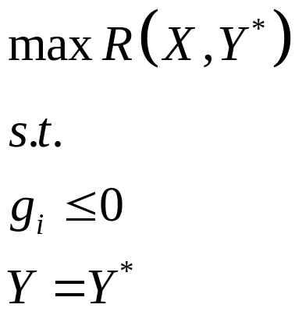
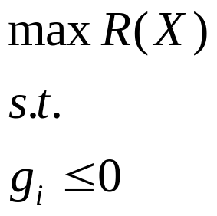
Example
Mathematically;
Introduce
surrogate
variables
Additional equality constraints

Slide 32


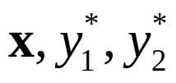
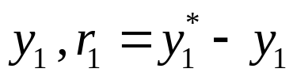

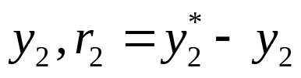
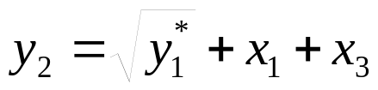


Example DSM (IDF)
SO

Slide 33
Example DSM (IDF)
SO
2 additional constraints and
more variables to handle,
But no more loop

Slide 34
Assignment
Work out the earlier presented example problem in an IDF optimization scheme in MatLab

